Slide 1
Data Visualization of Bird Strikes between 2000 - 2011

Slide 2
Introduction
The Bird Strikes Analysis Dashboard provides a detailed examination of bird strike incidents involving aircraft between 2000 and 2011. The dashboard offers insights into the frequency, severity, and impact of bird strikes on aircraft operations, along with the financial implications of these events. This analysis is crucial for improving aviation safety measures and mitigating risks associated with bird strikes, which pose significant threats to both aircraft and passengers.

Slide 3
Details of Data
1. Data Overview:
Source: The dataset includes records of bird strikes reported by various US airlines and airports from 2000 to 2011.
Attributes: The data captures the number of bird strikes, associated costs, damage severity, flight phases during strikes, and altitude.
2. Key Variables:
Bird Strikes: Total number of bird strikes reported, with detailed breakdowns by year, airline, airport, and flight phase.
Repair Costs: The financial cost associated with repairs due to bird strikes, totaling $136 million.
Damage Severity: Classification of strikes causing damage versus those that did not, with a focus on the impact on flight operations.
3. Data Segmentation:
Airlines: The data includes bird strike incidents for major US airlines such as Southwest Airlines, American Airlines, and Delta Air Lines.
Airports: Bird strikes are analyzed by the airport, with some airports experiencing higher frequencies than others.
Flight Phases: Data is segmented by flight phases (e.g., approach, take-off, landing) to identify when bird strikes are most likely to occur.

Slide 4
Main KPIs
1. Number of Bird Strikes:
Measure: The total number of bird strikes reported from 2000 to 2011.
Value: 24.75K strikes recorded.
2. Financial Impact:
Measure: The total cost incurred for aircraft repairs due to bird strikes.
Value: $136 million in repair costs.
3. Damage Severity:
Measure: The percentage of bird strikes that caused damage to aircraft versus those that did not.
Values:
No Damage: 90.37% of strikes.
Caused Damage: 9.63% of strikes.

Slide 5
Main KPIs
4. Altitude of Bird Strikes:
Measure: The altitude at which bird strikes occurred.
Values:
Below 1000 feet: 80.72% of strikes.
Above 1000 feet: 19.28% of strikes.
5. Airline and Airport Specific Data:
Measure: The number of bird strikes reported by different airlines and airports.
Highlight: Top airlines and airports with the most frequent bird strike incidents, such as Southwest Airlines and Atlanta International Airport.
6. Flight Phase Analysis:
Measure: The flight phases during which most bird strikes occur.
Highlight: Most bird strikes occur during the approach phase, followed by landing and take-off.

Slide 6
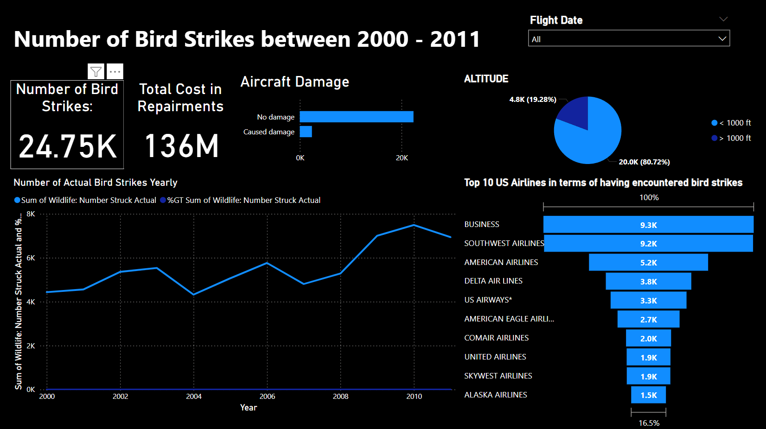
Dashboard

Slide 7
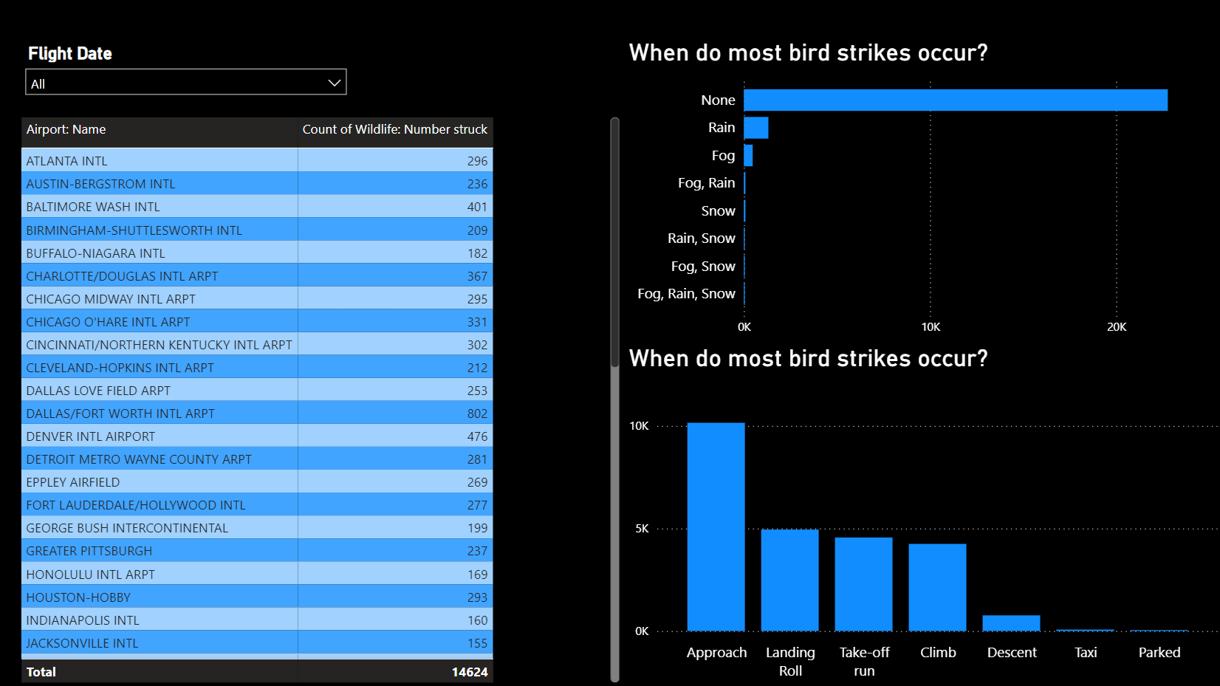
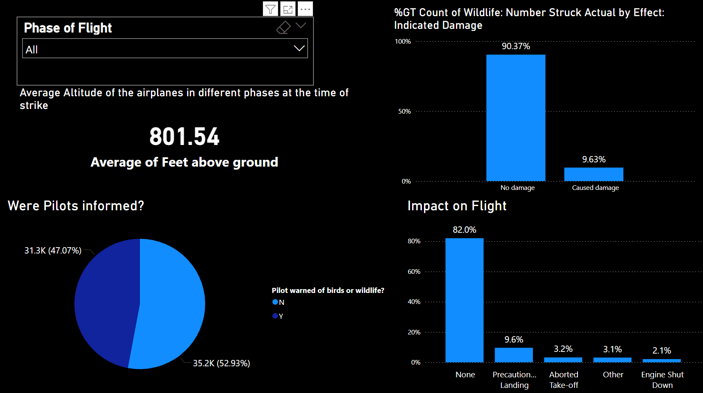
Dashboard

Slide 8
Thank you

